Slide 1

predictive representations to abstract temporal information
Tejas Savalia

Slide 2

What is the pattern here?
Notes:
Make video bigger and shorter, slide prettier

Slide 3



Outline
Comparing Representations of Temporal Pattern Recognition
Assessing the Properties of Implicit Event Boundaries
Learning Categories through Implicit Event Structure
Notes:
Say how this preso is filtered.

Slide 4
Outline
Comparing Representations of Temporal Pattern Recognition
Assessing the Properties of Implicit Event Boundaries
Learning Categories through Implicit Event Structure
Notes:
Say how this preso is filtered.

Slide 5
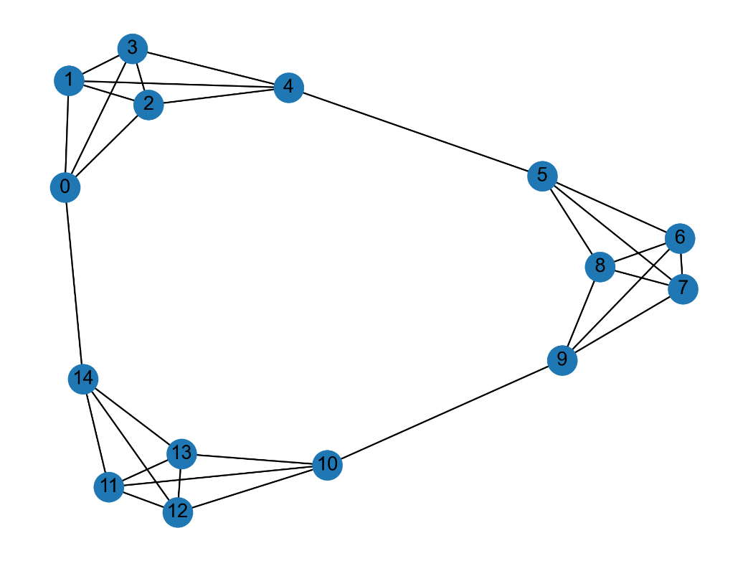
Temporal Patterns
Random
Walk
Notes:
Each node is associated with a stimulus.
Shorter random walk, probability.

Slide 6
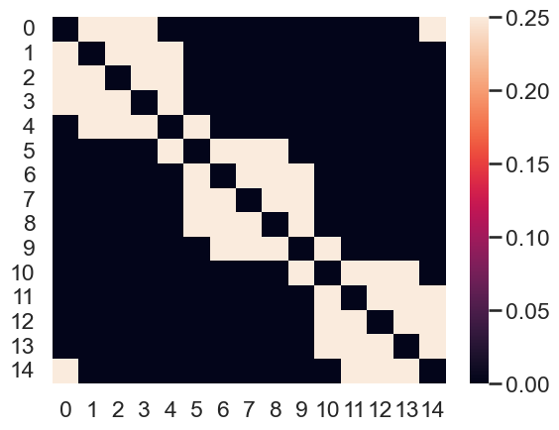
Representing Temporal Structure through Transition Matrix
Transition Probability
Nodes (rows) represented as a ‘context’ of other nodes (columns)
Notes:
Probability represented as transition matrix. Fix animations.
Explicitly Label nodes and cells.

Slide 7
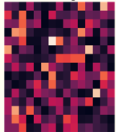
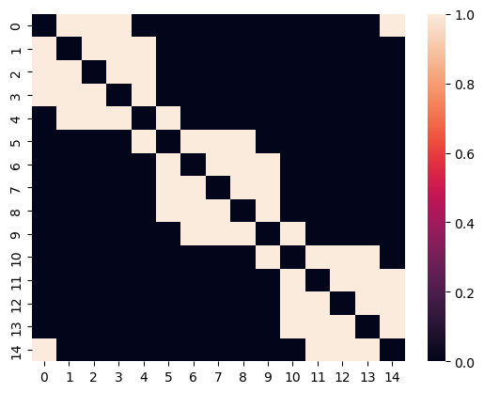

Goal: Learning the Transition Matrix
Context representation assuming no knowledge of the graph
Context representation with complete knowledge of the graph
Notes:
Remove labels from second heat map. Each row is a node.
Say the goal thing explicitly.
Change backgrounds.

Slide 8
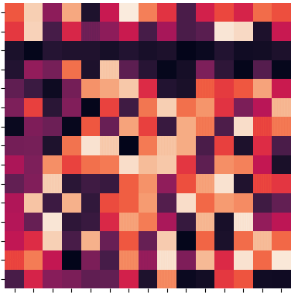
Mechanisms to Learn the Transition Matrix
Predictive Representation (SR)
Associative
Representation (TCM)
Context representation assuming no knowledge of the graph
Learned Context Representation
Gershman (2013), Dayan (1993), Kahana (2003)
Notes:
Once sentence definitions.

Slide 9
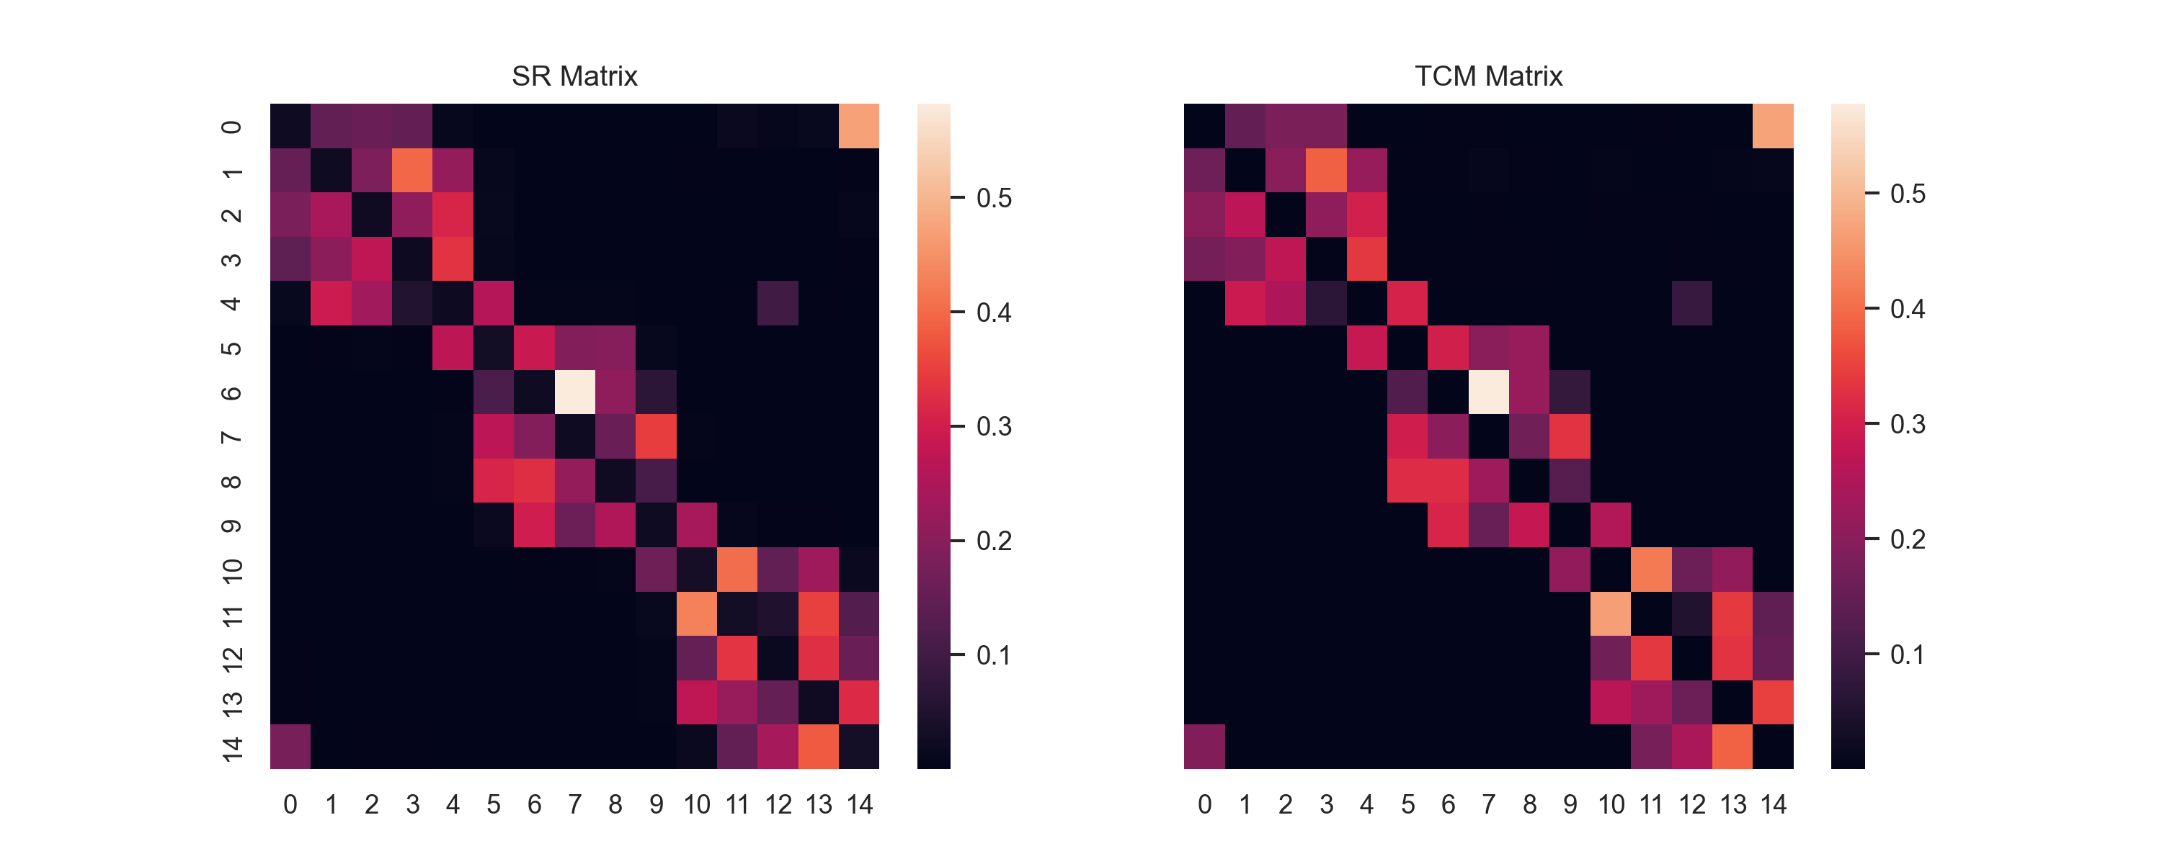

Context Representation Shaped Over Time
Learned Predictive Representation
Learned Associative Representation
Notes:
Fix animation
While showed example video had explicit shifts, for the algorithms that’s not ndeedde.

Slide 10
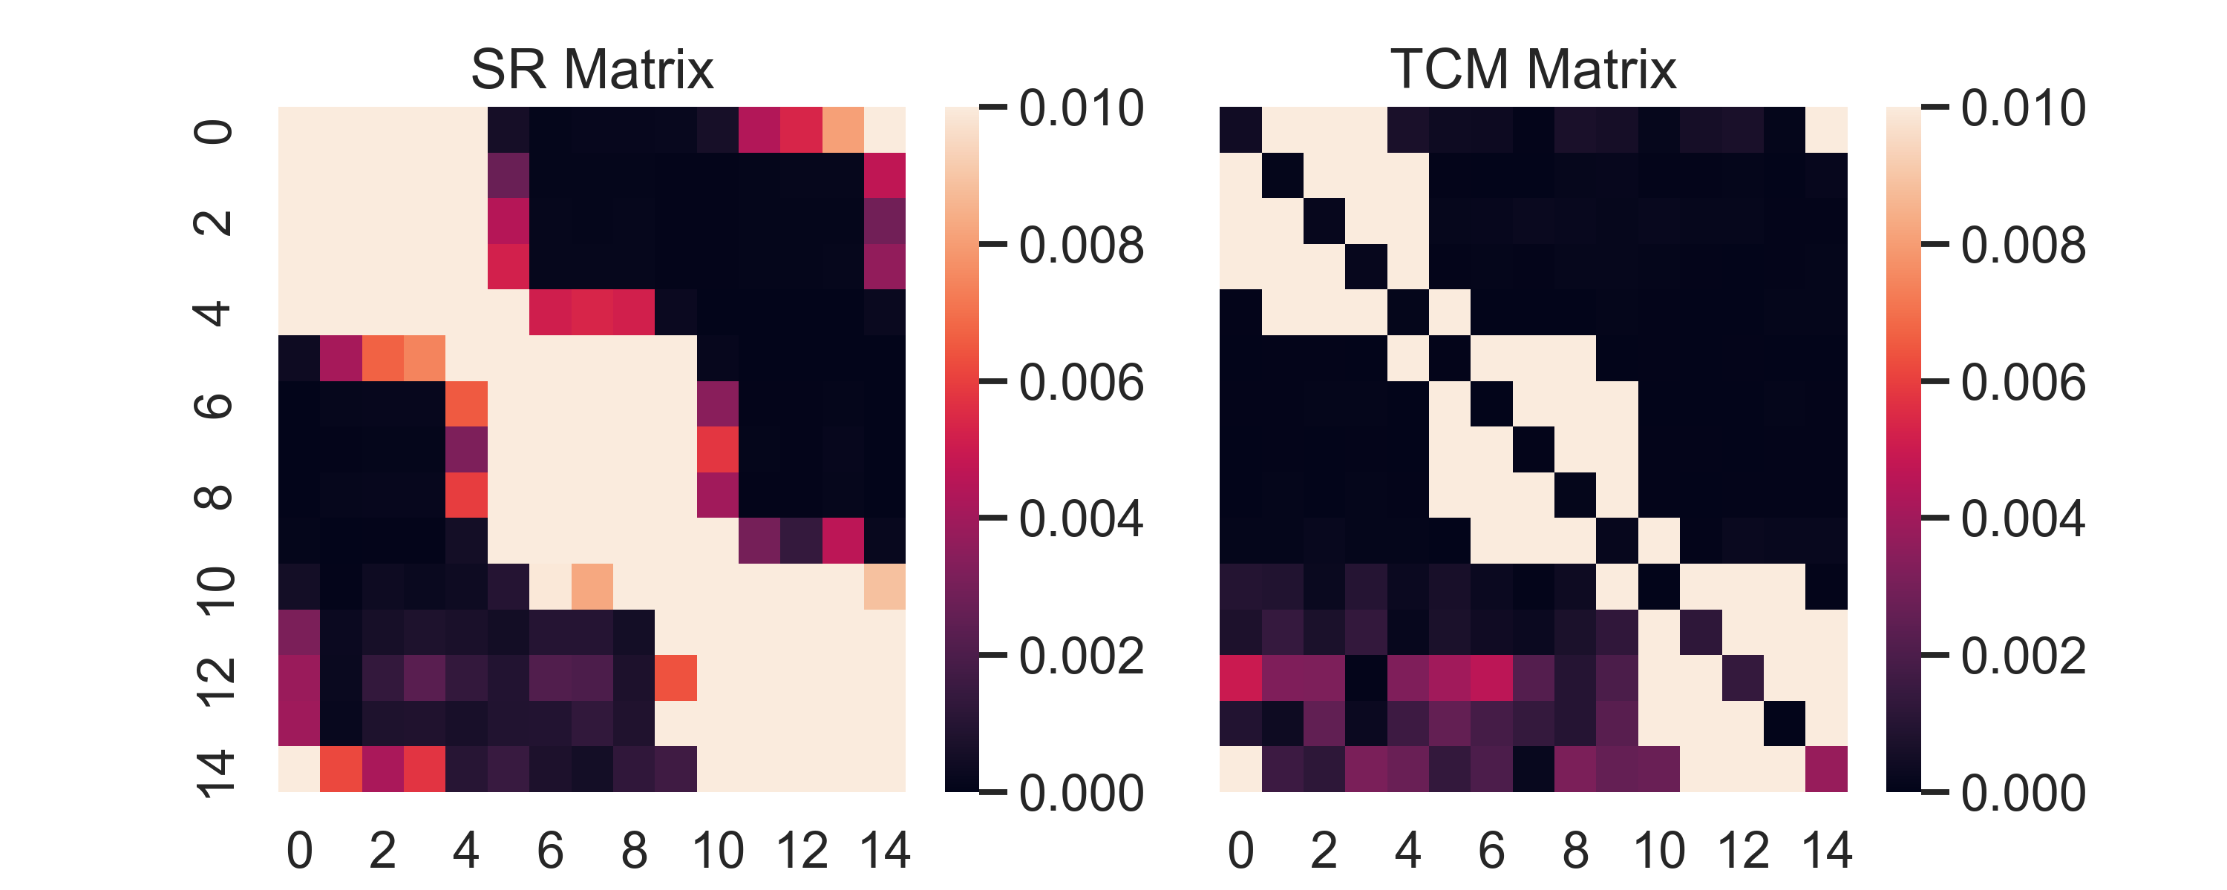
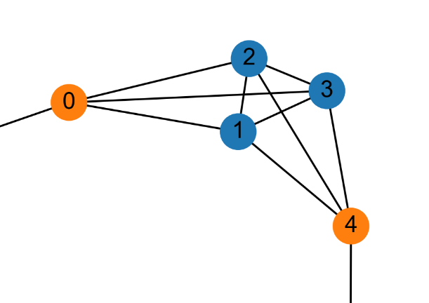
Comparing the Predictive and Associative Representations
Predictive Representation
Associative Representation
Notes:
Transition into this with probabilities.

Slide 11
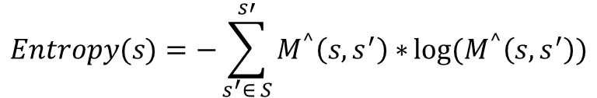
Measuring Node Information
Predictive Representation
Associative Representation
$$Entropy(s)={−\sum_{s^{′}∈ S}^{s′}{M^{^}\left(s, s^{′}\right)∗}log⁡(M}^{^}\left(s, s^{′}\right))$$

Slide 12
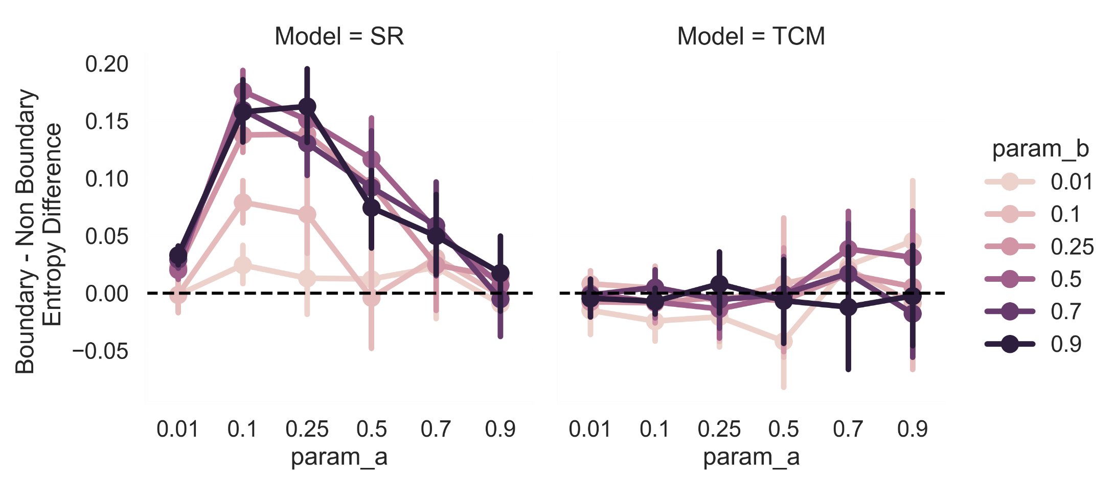
Expected Boundary Information Differences
Predictive Representation
Associative Representation
Notes:
Say simulation that will be tested.

Slide 13
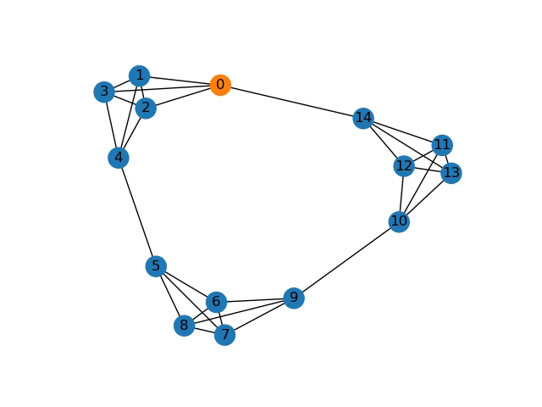
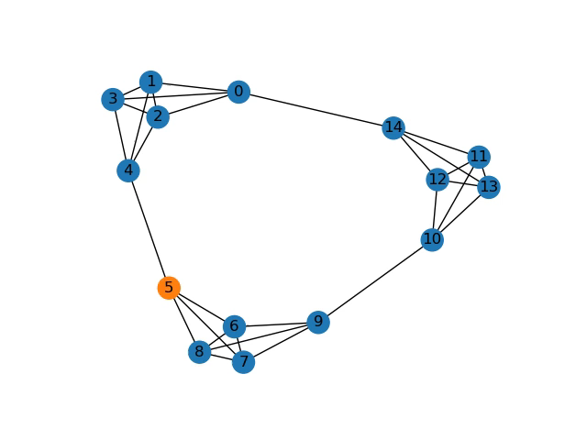
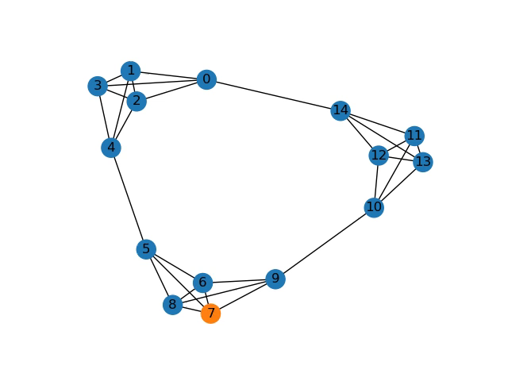
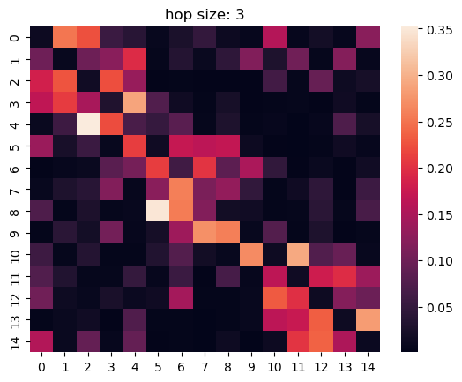
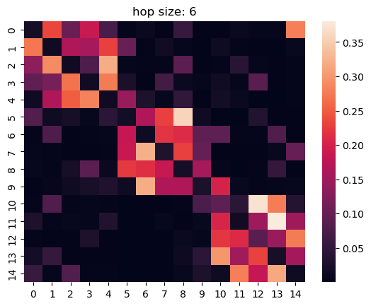
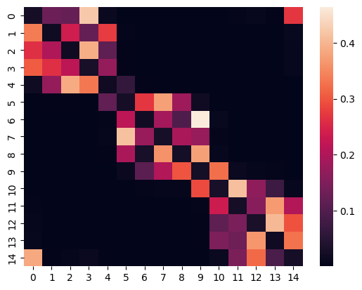
Learned Representations over Walk Lengths
Random walk Length 3
Random walk Length 6
Random walk Length 1399
Notes:
Shorter random walk = rep not learned as well.

Slide 14
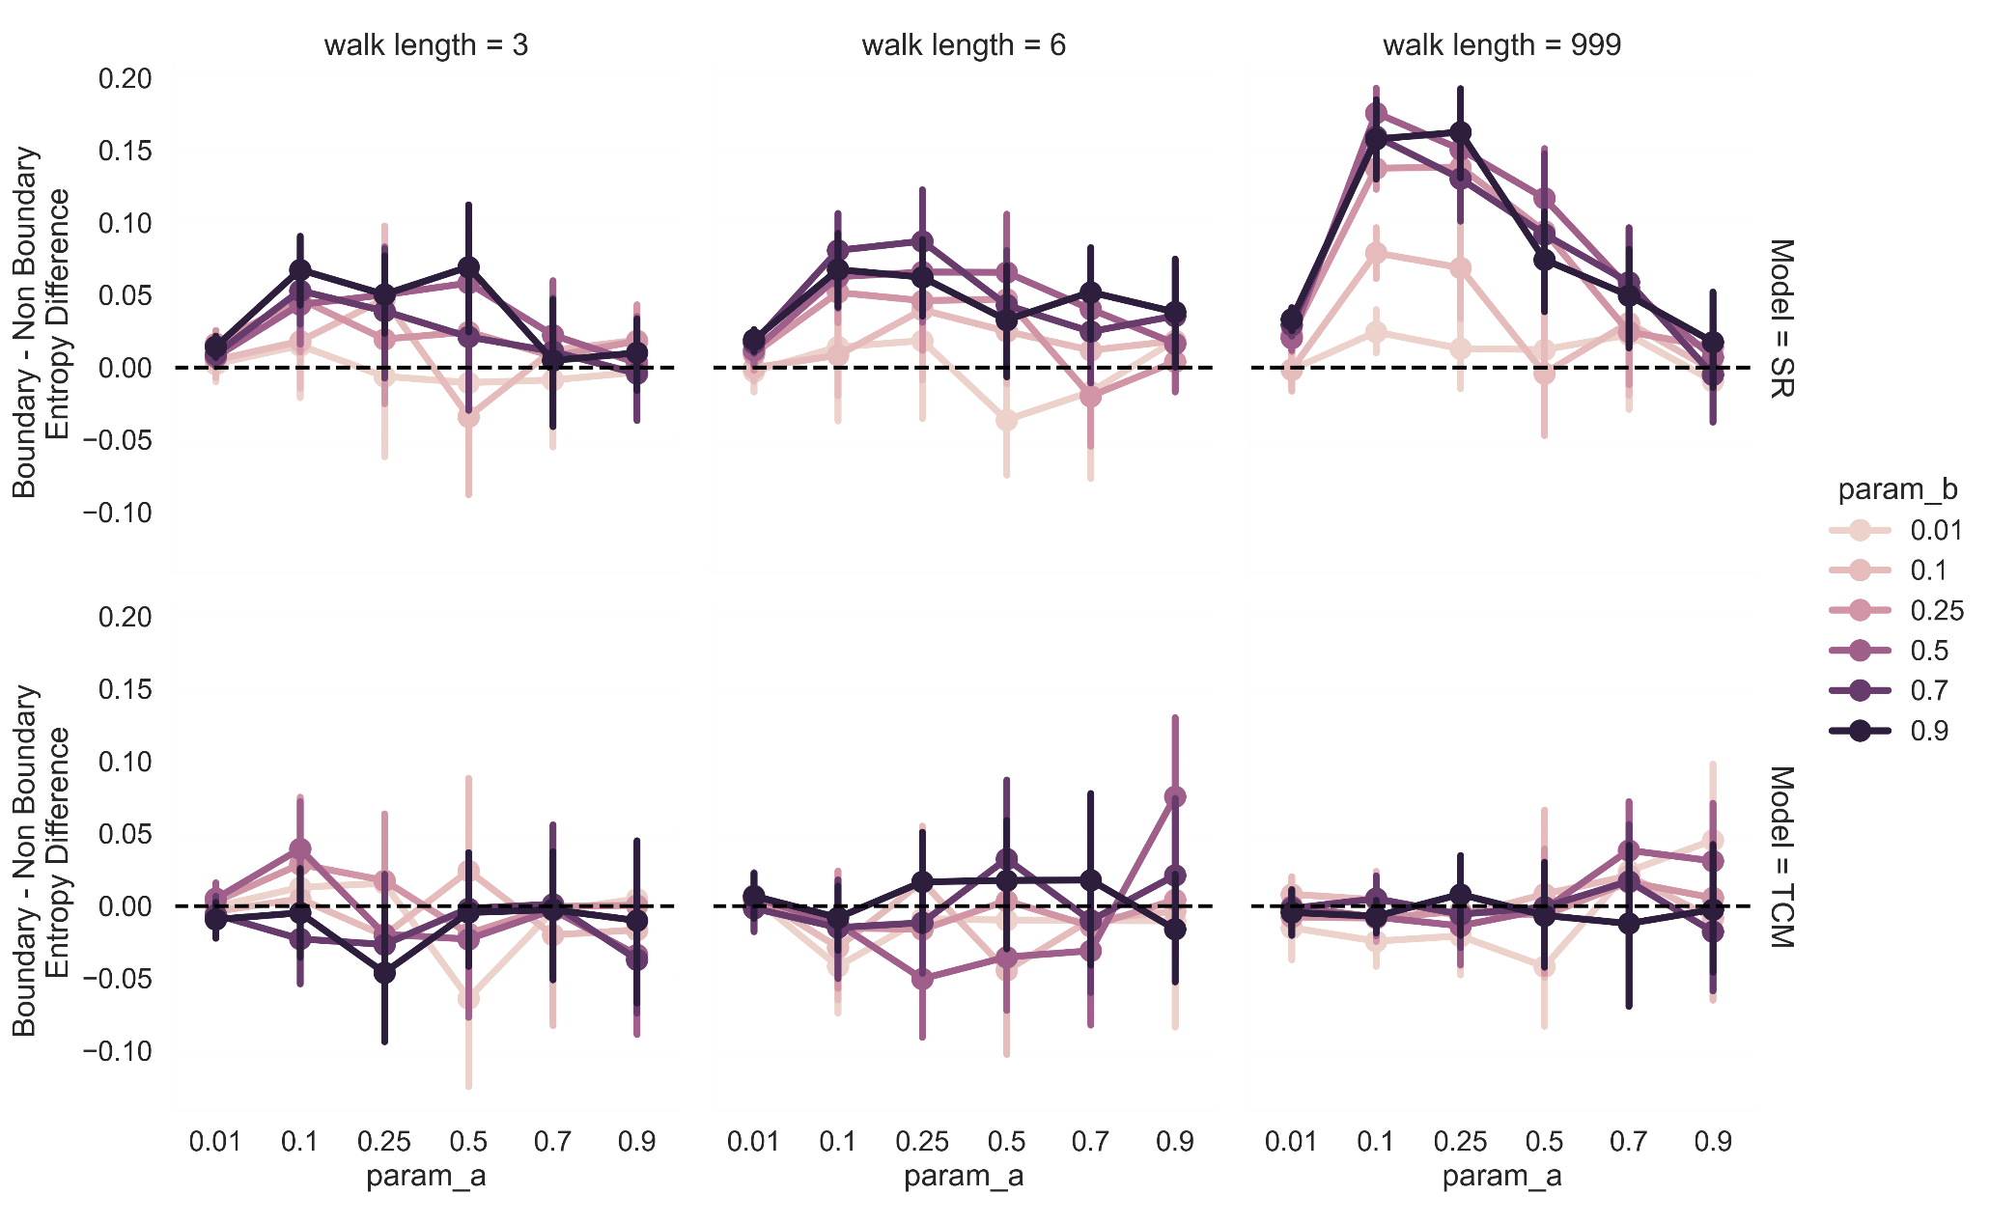
Predictive vs Associative Representations
Walk Length 3
Walk Length 6
Walk Length 1399
Predictive
Representation
Associative
Representation
Notes:
Define y axis explicitly.

Slide 15
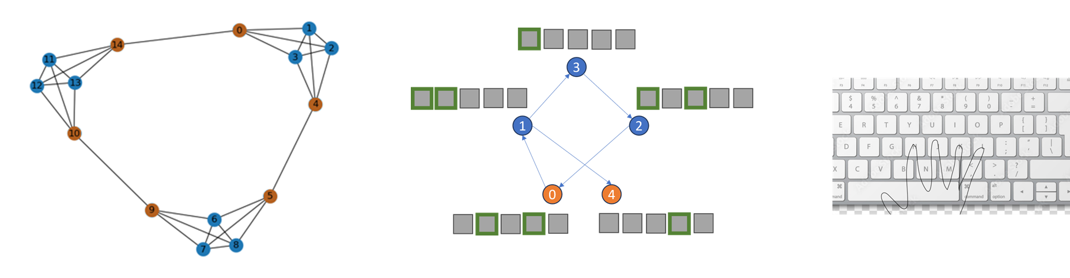

Experiment 1: Serial Reaction Time Task
Design
Task
N = 113
Trials: 1400 (Break every 200 trials)
Between Subjects: Walk Length 0, 3, 6, 1399
Kahn et al. (2018)
Notes:
Shorter

Slide 16

Critical Transitions
b-to-nb
b-to-b
nb-to-b
nb-to-nb
Boundary Effect = nb_to_b – nb_to_nb
Notes:
Animate.

Slide 17
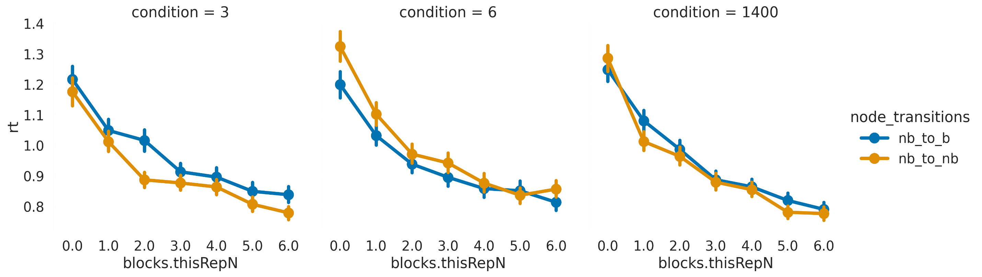
Median Response Times After Critical Transitions
walk length: 3
walk length: 6
walk length: 1399
Blocks
Blocks
Blocks

Slide 18
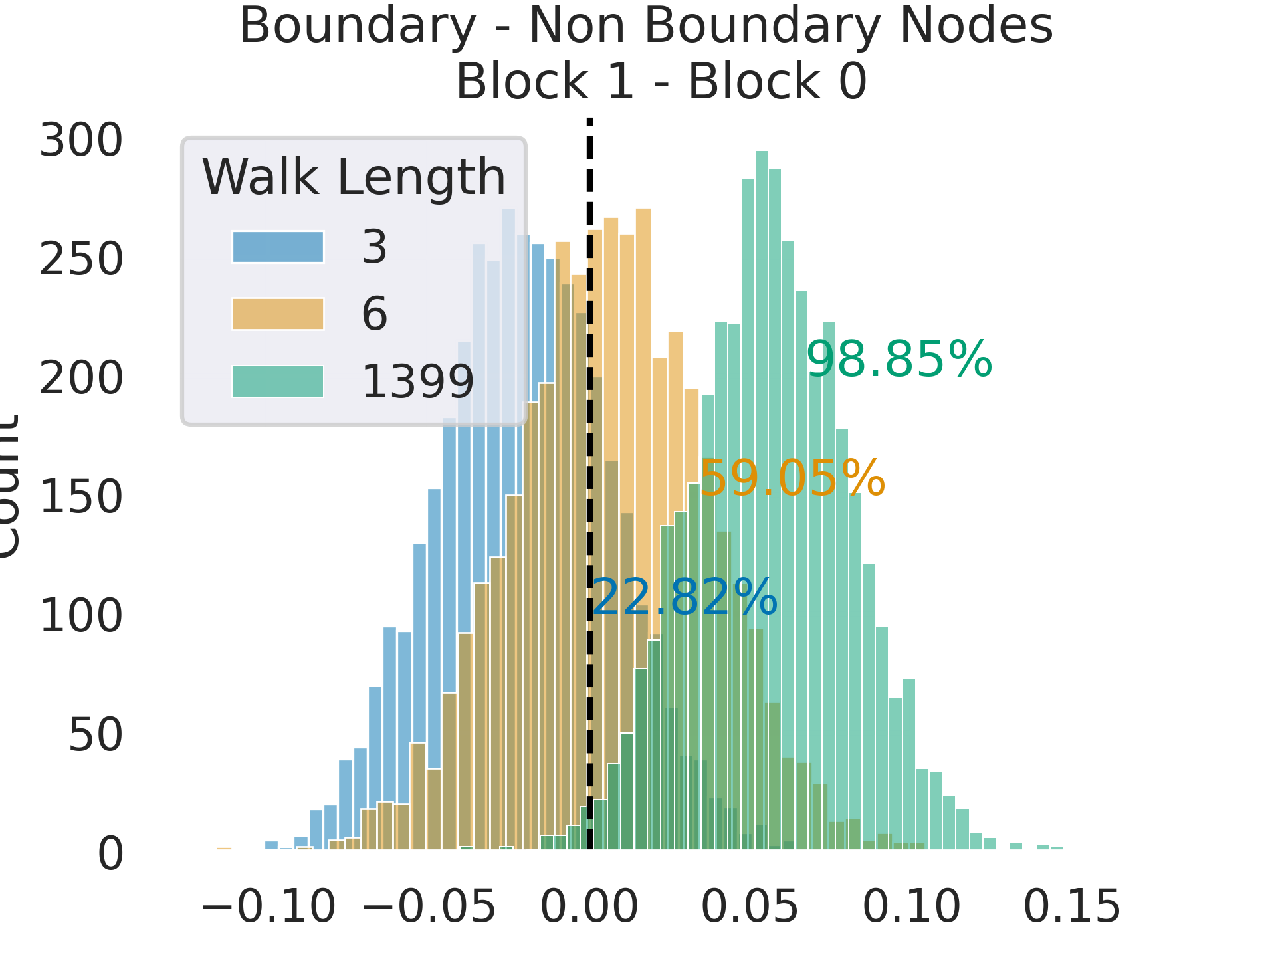
Results: Estimated Differences
Support for Predictive Representations over Associative Representations
Increased Boundary Slowdown
Notes:
Call out the statistical thing (distro shift to the right as walk length increases)
Make box bigger, sentence case. Explicitly say associative rep doesn’t predict this.

Slide 19
Outline
Comparing Representations of Temporal Pattern Recognition
Support for Predictive Representations
Assessing the Properties of Implicit Event Boundaries
Learning Categories through Implicit Event Structure
Notes:
Shorter subtitles. Title case. Say how this preso is filtered.

Slide 20
Outline
Comparing Representations of Temporal Pattern Recognition
Support for Predictive Representations
Assessing the Properties of Implicit Event Boundaries
Learning Categories through Implicit Event Structure
Notes:
Shorter subtitles. Title case. Say how this preso is filtered.

Slide 21

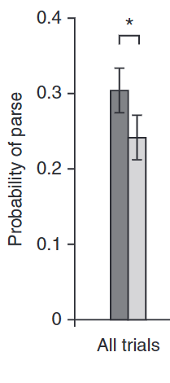
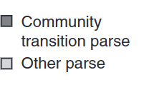
Are these ‘Event Boundaries’?
Schapiro et al. (2013)
Notes:
Be slow. Cite.

Slide 22
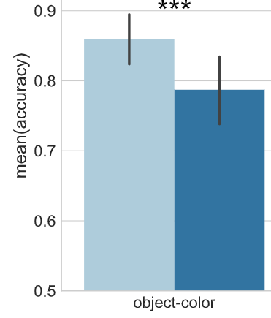
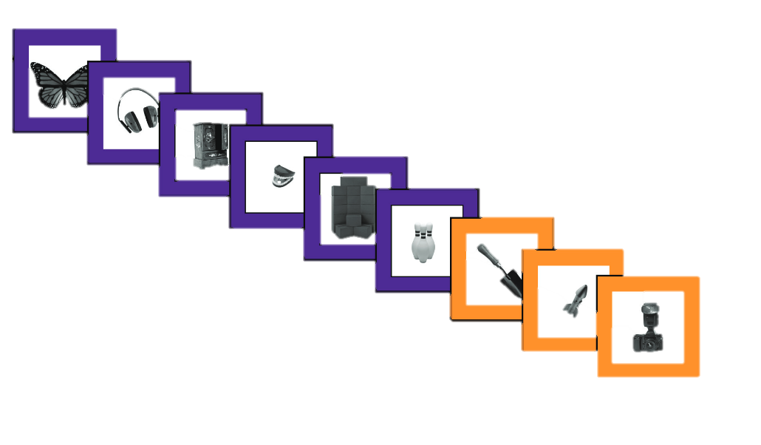

Event Boundaries with Explicit Context Shifts are Remembered Better
Exposure
Memory Test
Trials
Boundary Items
Non-Boundary
Items
Memory Accuracy
Heussar et al. (2018)
Are Implicit Event Boundaries Remembered Better?
Notes:
Capitalization
Bigger

Slide 23
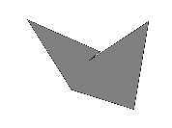
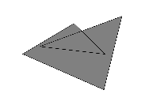

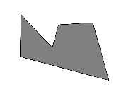
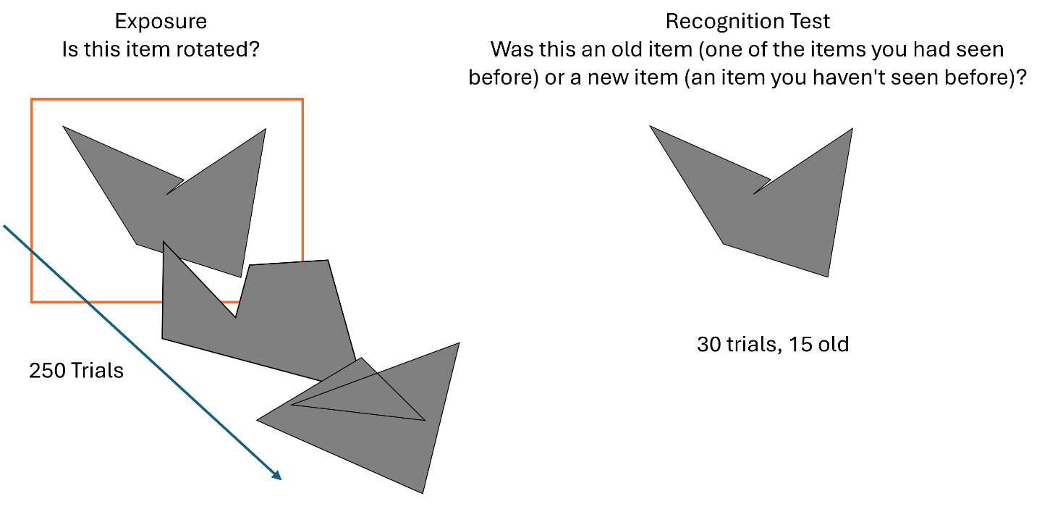
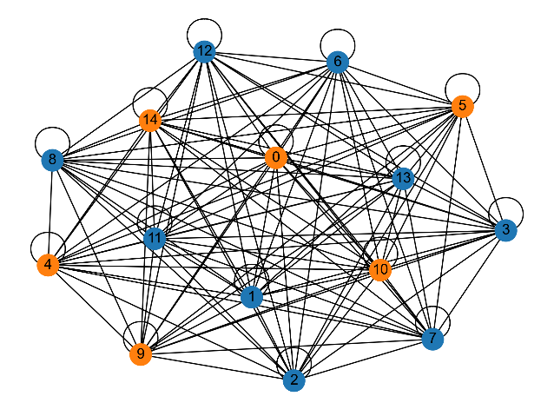
Experiment 3a: Recognition Memory Test
Design
Task
Structured Graph
(27 participants)
Unstructured Graph
(30 participants)
3 blocks (750 exposure, 90 test trials)

Slide 24
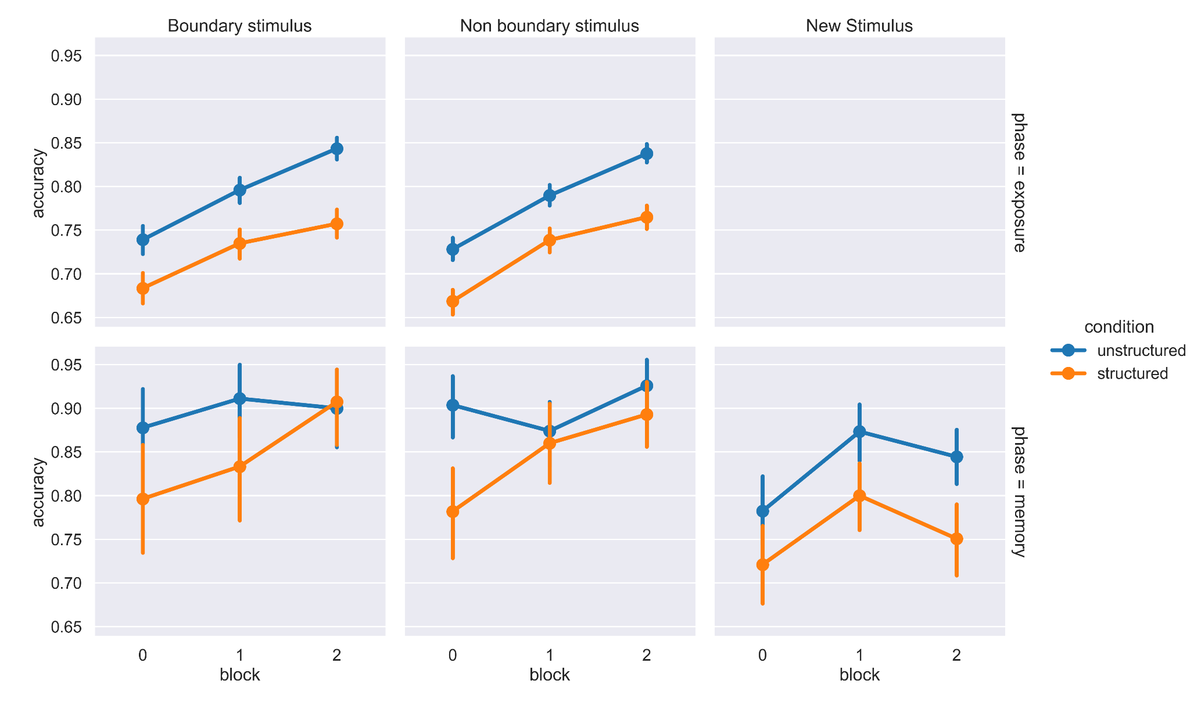
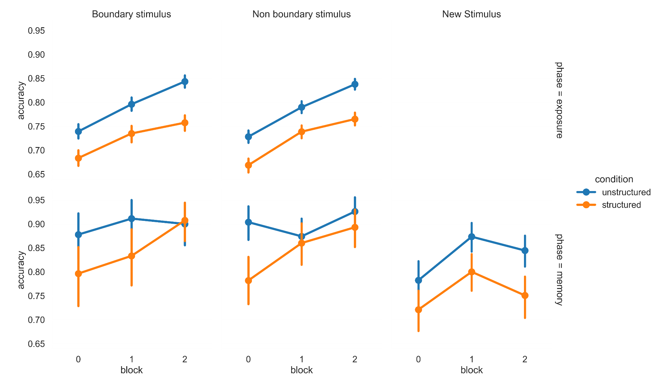
Experiment 3a Recognition Accuracy
Exposure
Phase
Recognition Test
Phase
Notes:
Visually Divide them.
Conditions bigger.
Row labels on the left

Slide 25
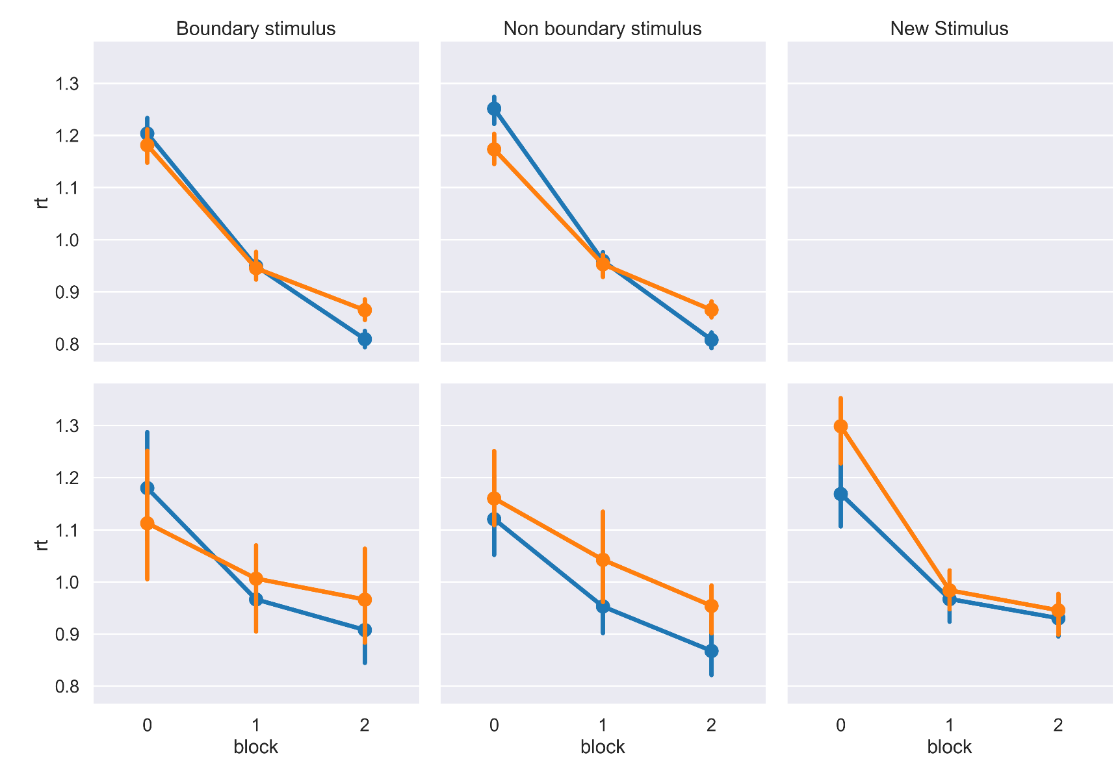
Experiment 3a Median Response Times
Exposure
Phase
Recognition Test
Phase

Slide 26
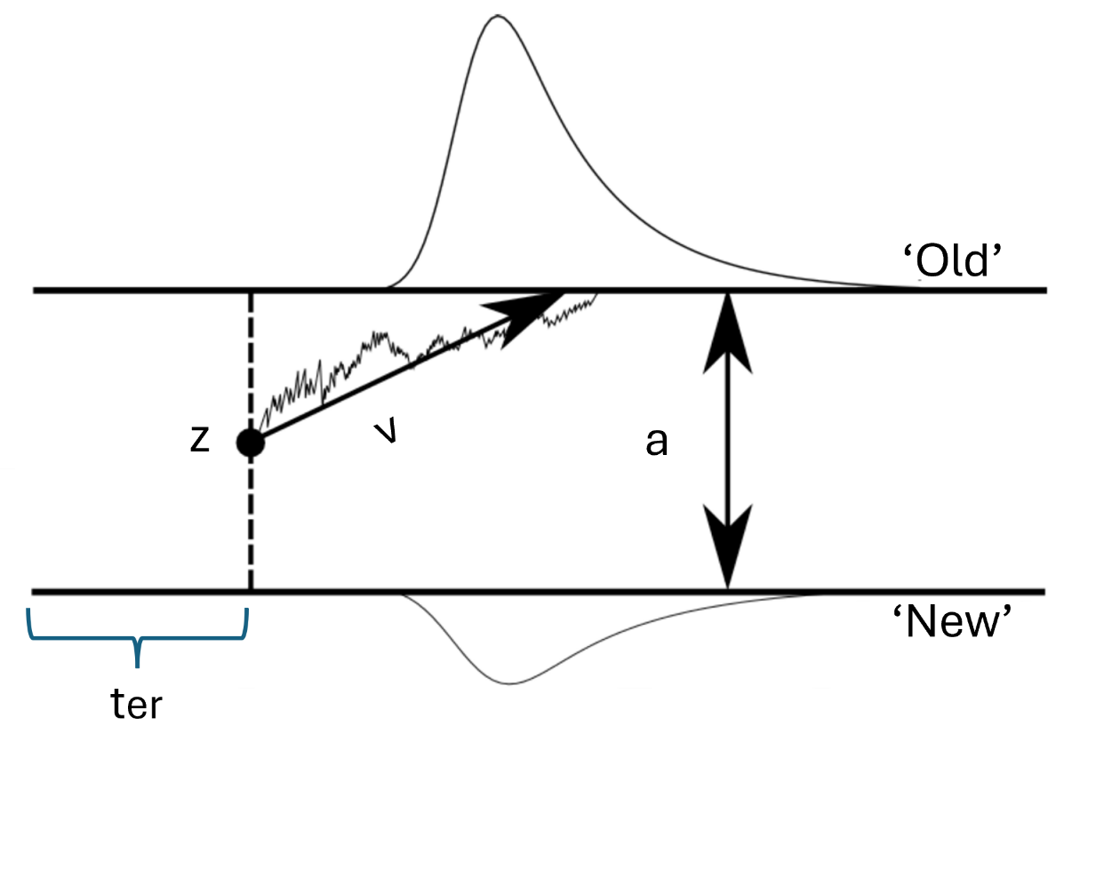
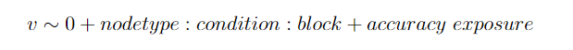
Drift Diffusion Modeling for Choices and Response Times
Ratcliff et al. (2003)
Notes:
Just point to drift rate.
Just write the first line.

Slide 27
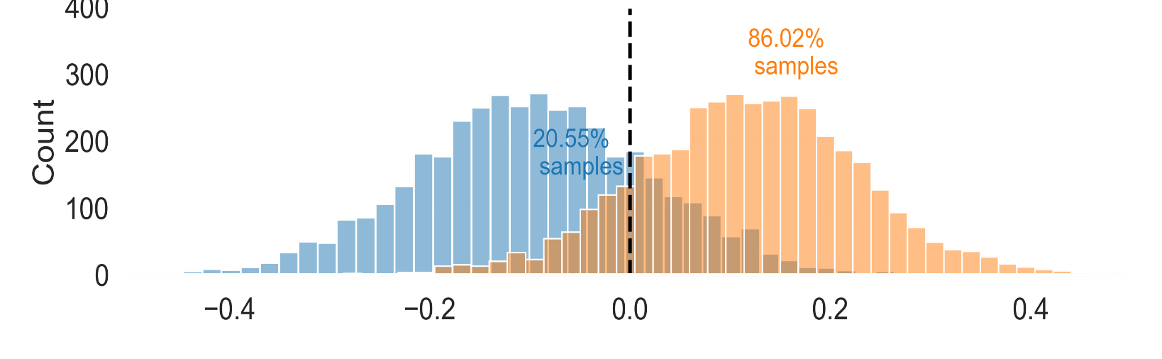
Experiment 3a Results: Diffusion Model Results
Final Block
Implicit Event Boundaries are Remembered Better.
Boundary – Non-Boundary
Drift Rate Difference
Notes:
Legend. Walk through graph.
Bloww up

Slide 28
Outline
Comparing Representations of Temporal Pattern Recognition
Support for Predictive Representations
Assessing the Properties of Implicit Event Boundaries
Implicit Boundaries are Remembered Better
Learning Categories through Implicit Event Structure
Notes:
Say how this preso is filtered.

Slide 29
Outline
Comparing Representations of Temporal Pattern Recognition
Support for Predictive Representations
Assessing the Properties of Implicit Event Boundaries
Implicit Boundaries are Remembered Better
Learning Categories through Implicit Event Structure
Notes:
Say how this preso is filtered.

Slide 30
Attention to Features
Categorized by shape; not size or color
Can attention to category defining features be modulated by temporal structure?

Slide 31


Experiment 3a: Implicit Category Learning Stimuli
Orientation
Color
Size
Shape
Size
Shape
Color
Orientation
Notes:
Label things; and just state the higher level variables (8 bin features .

Slide 32


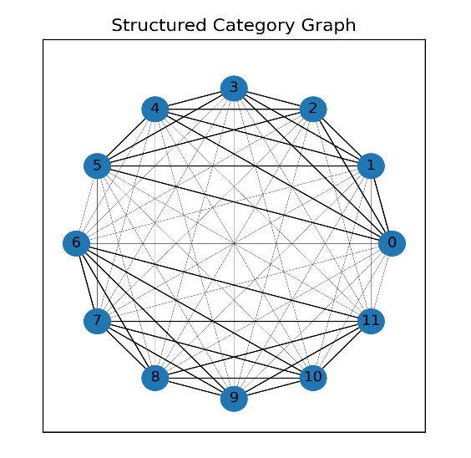



Temporally Consistent Features
Torso color changes within a cluster
“Non-category diagnostic feature”
Higher Transition Probability
Head color changes across clusters
“category diagnostic feature”
Lower Transition Probability
Torso color changes within a cluster “Non-category diagnostic feature”

Slide 33
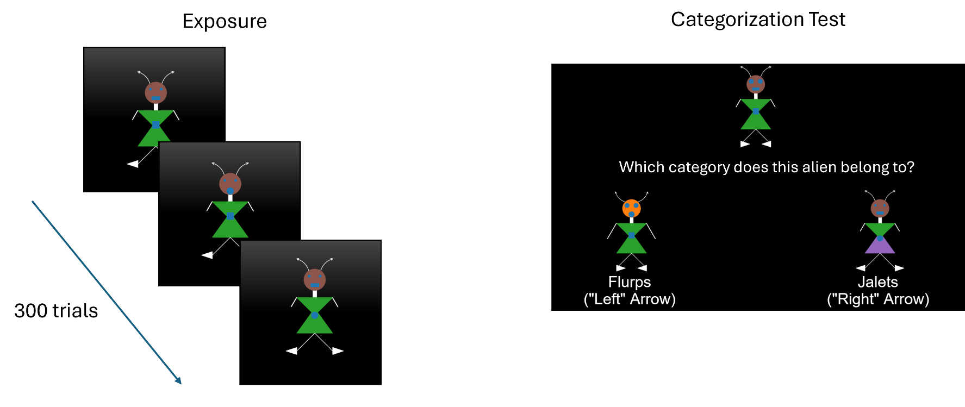
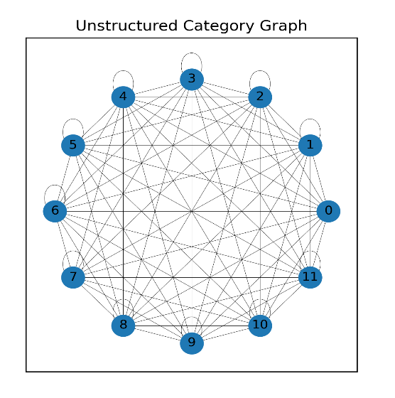
Experiment 3a: Implicit Category Learning Task
Design
Task
Structured Graph
29 Participants
Match on all Non- Category Features
Mismatch on 1-4 Category Features
Match on all
Category Features
Mismatch on 1-4 Non-Category Features
Unstructured
Graph
28 Participants
Notes:
Example alien at the nodes.
Add a structured graph slide before this one.

Slide 34
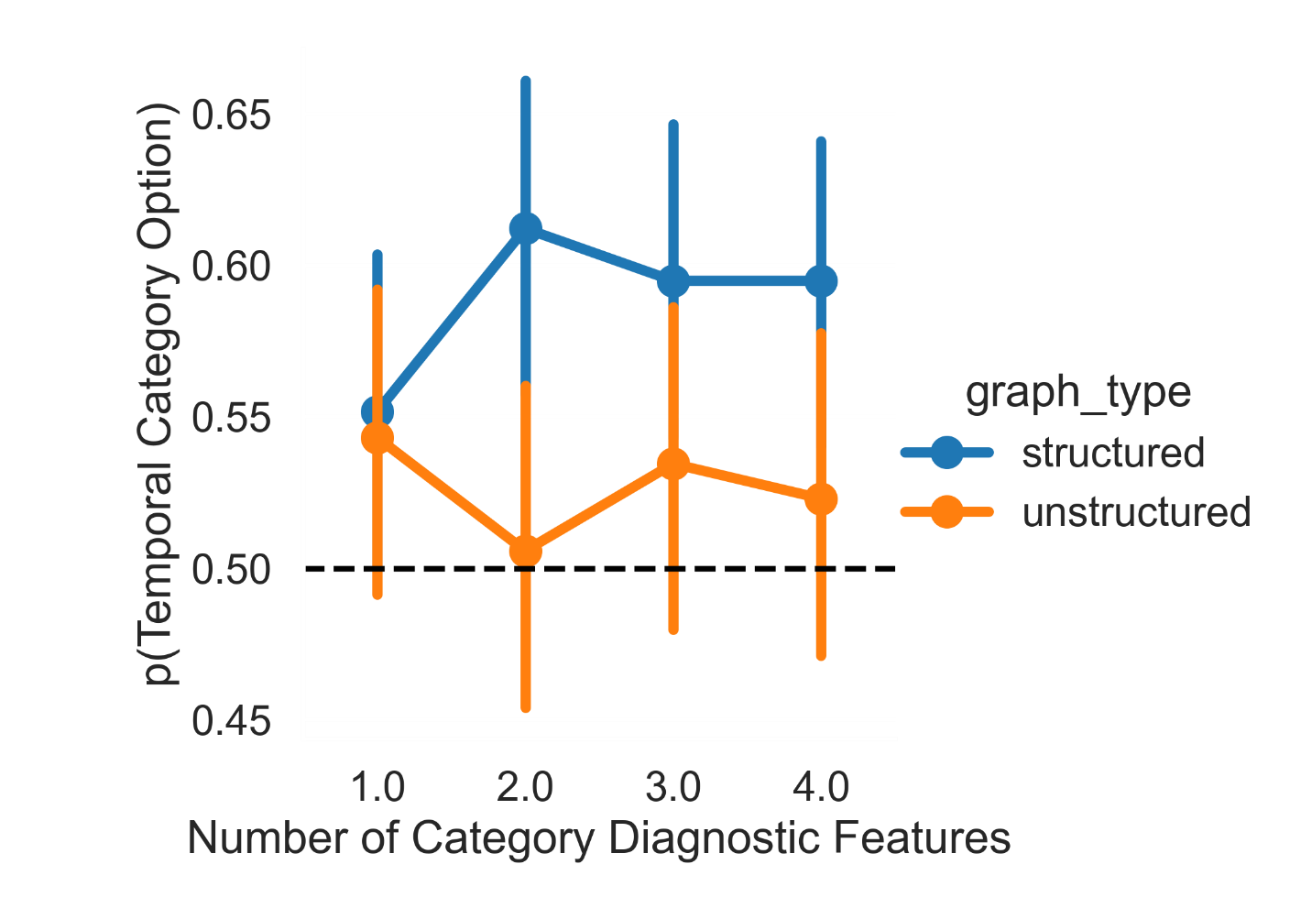
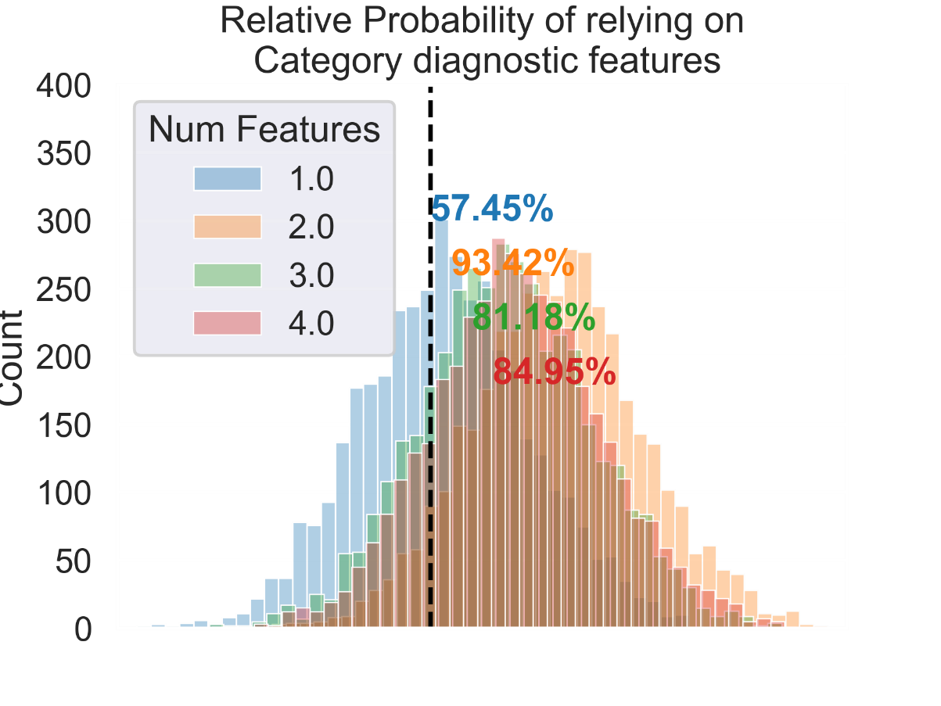
Experiment 3a: Results
No. Mismatched Features
Increased chance of selecting
temporal category option

Slide 35
Outline
Comparing Representations of Temporal Pattern Recognition
Support for Predictive Representations
Assessing the Properties of Implicit Event Boundaries
Implicit Boundaries are Remembered Better
Learning Categories through Implicit Event Structure
Some effect of temporal clustering (but exact nature is unclear).
Notes:
Shorter subtitles. Title case. Say how this preso is filtered.

Slide 36
Conclusions
People rely on predictive representations for statistical learning.
Not in thesis: Temporally learned musical associations.
Implicit event boundaries share some characteristics (better boundary memory) with explicit event boundaries.
In thesis: No evidence for temporal stretching for events across boundaries.
Not in thesis: Meaningful stimuli lead to some temporal stretching.
Temporal consistency may draw attention towards category diagnostic features.
In thesis: Temporal modulation may depend on a feature’s inherent perceptual properties.
Not in thesis: Randomly picked features divide people’s attention towards categories.
Notes:
Animate.
Takeaways/implications.

Slide 37
Implications/ Future Work
Experimental:
Implementational investigation of Algorithmic Accounts (e.g. in Hippocampus, over development).
Testing other Explicit Boundary properties like scan and replay points.
Feature importance-controlled Category Learning.
Modeling:
Estimating model parameters, Predecessor Representation + Working Memory considerations.
Modeling boundary replay and memory scanning for implicit boundaries.
Update known models to account for order effects in category learning.
Practical:
Social Psych – Cross-Race effects due to temporal proximity in experience.
Developmental/Ed Psych – Teaching complex concepts through pattern recognition.

Slide 38
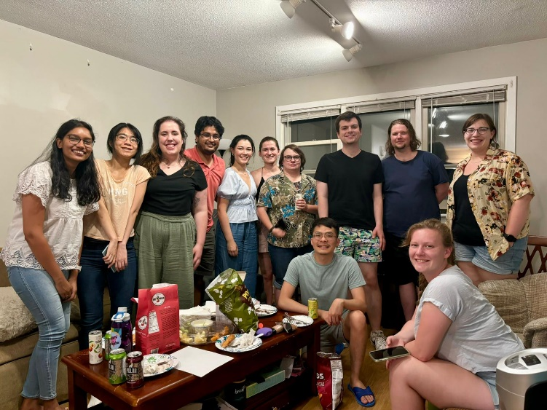
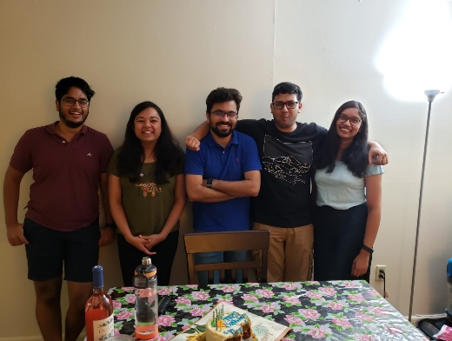

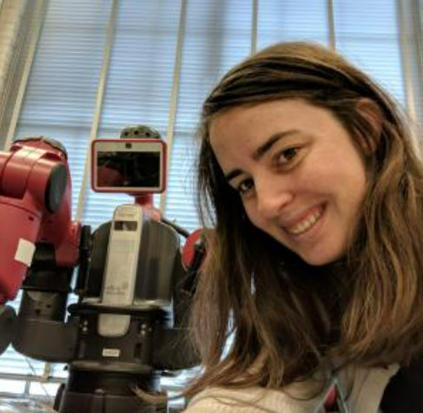

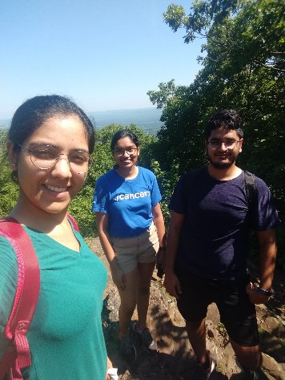




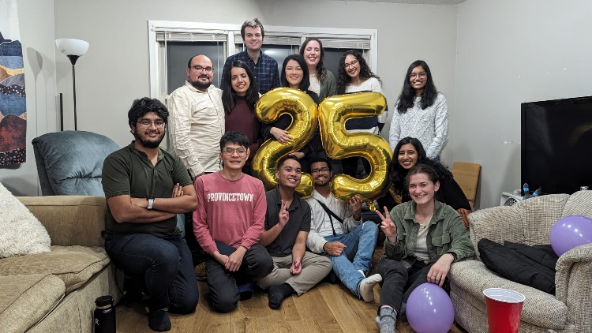




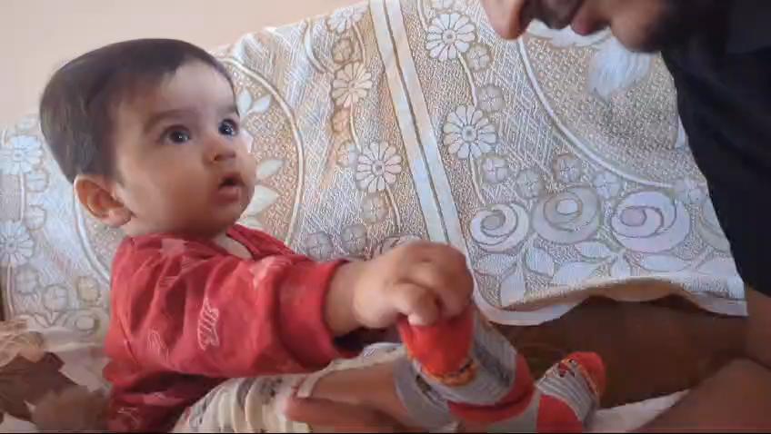
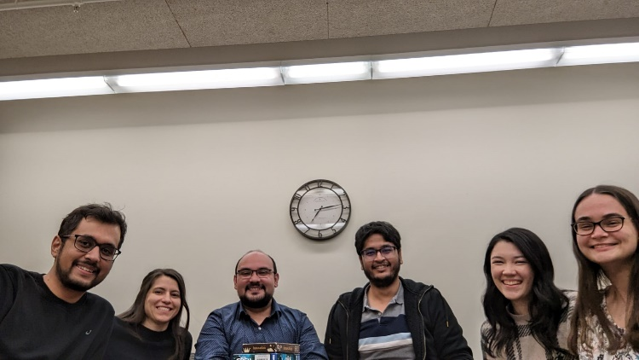
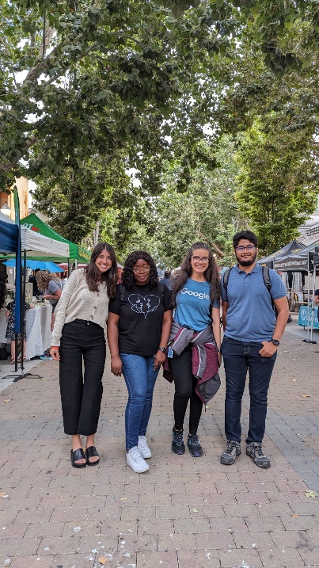
Acks
All RAs who have helped collect data over the years!

Slide 39

Thank you!

